Slide 1

FAIR Data
Willeke de Haan, Research Coordination Office

Slide 2
FAIR principles
Findable
Accessible
Interoperable
Reusable

Slide 3
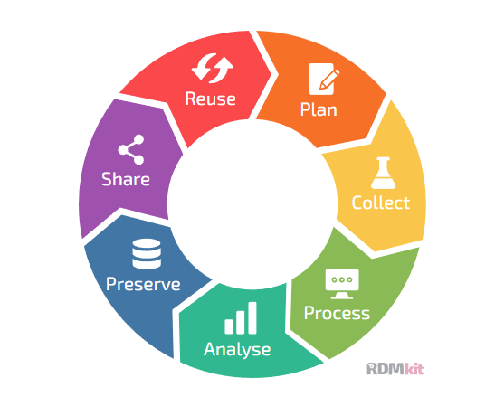
Data life cycle

Slide 4
Data life cycle

Slide 5
Is existing data available for your project?
Avoid having to repeat an experiment that was already done
By yourself or your group in a previous project
Data received from a colleague
Data that you got from the government or a company
Data that you bought
Data shared by other researchers in a trusted Data Repository

Slide 6

Findable
Via journal paper
Via search engine
Via search in repository
Persistent Identifier (PID)
Metadata: data about data
Title, Author, Keywords etc.

Slide 7
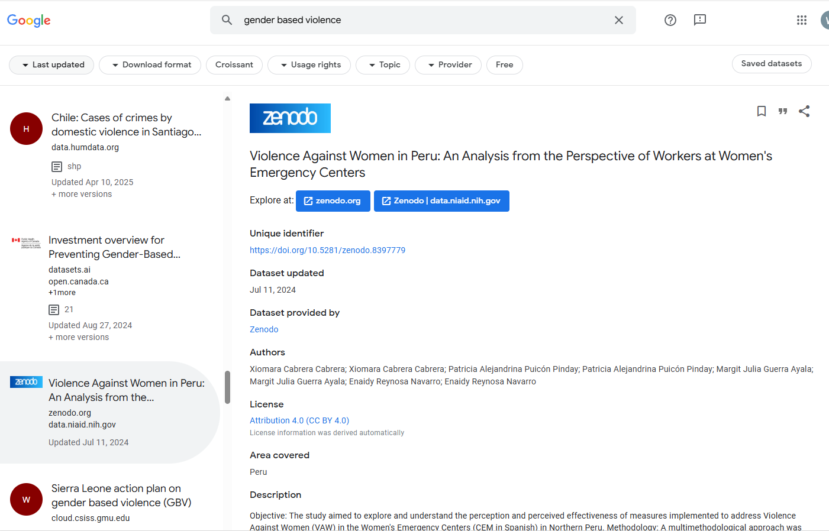

Slide 8

Accessible
Klick on download link
Request the dataset

Slide 10
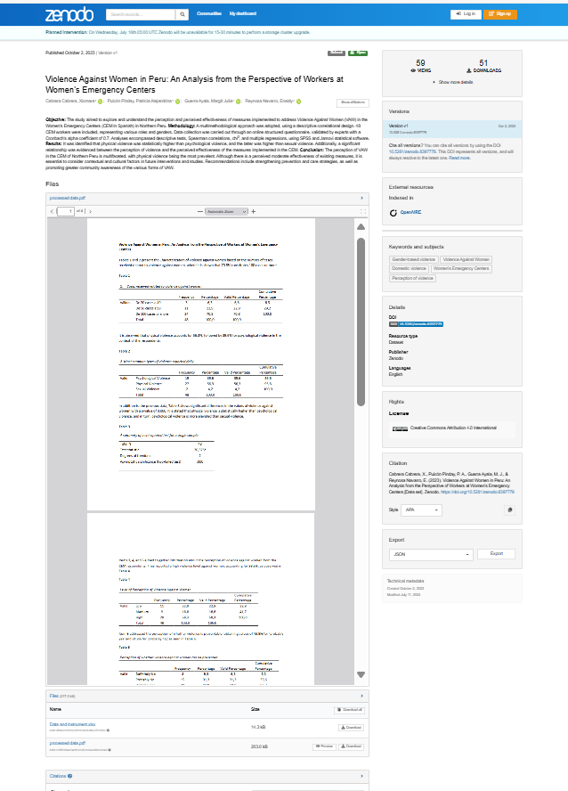
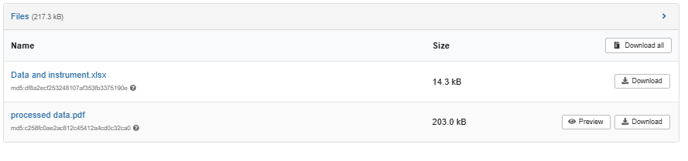
Cabrera Cabrera, X., Puicón Pinday, P. A., Guerra Ayala, M. J., & Reynosa Navarro, E. (2023). Violence Against Women in Peru: An Analysis from the Perspective of Workers at Women's Emergency Centers [Data set]. Zenodo. https://doi.org/10.5281/zenodo.8397779

Slide 11

Interoperable
Understand the dataset
Know how the dataset is linked with other data
Standards
Vocabularies

Slide 12
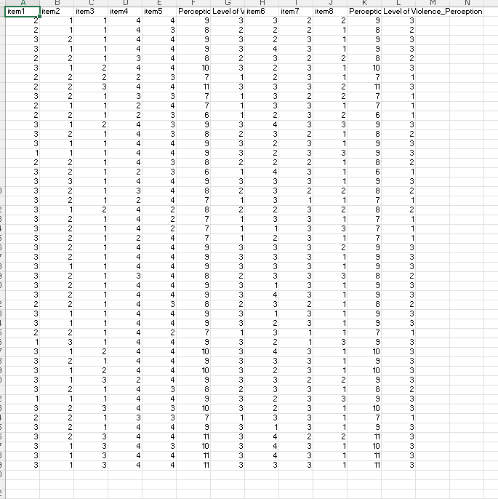
Cabrera Cabrera, X., Puicón Pinday, P. A., Guerra Ayala, M. J., & Reynosa Navarro, E. (2023). Violence Against Women in Peru: An Analysis from the Perspective of Workers at Women's Emergency Centers [Data set]. Zenodo. https://doi.org/10.5281/zenodo.8397779

Slide 13
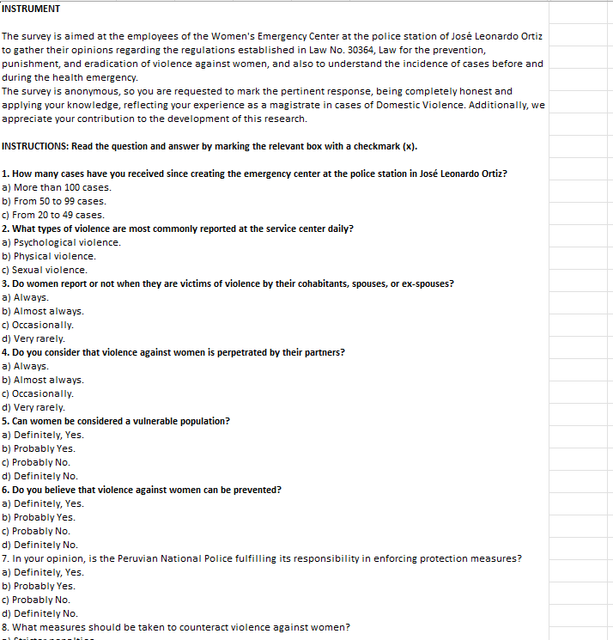
Cabrera Cabrera, X., Puicón Pinday, P. A., Guerra Ayala, M. J., & Reynosa Navarro, E. (2023). Violence Against Women in Peru: An Analysis from the Perspective of Workers at Women's Emergency Centers [Data set]. Zenodo. https://doi.org/10.5281/zenodo.8397779

Slide 14
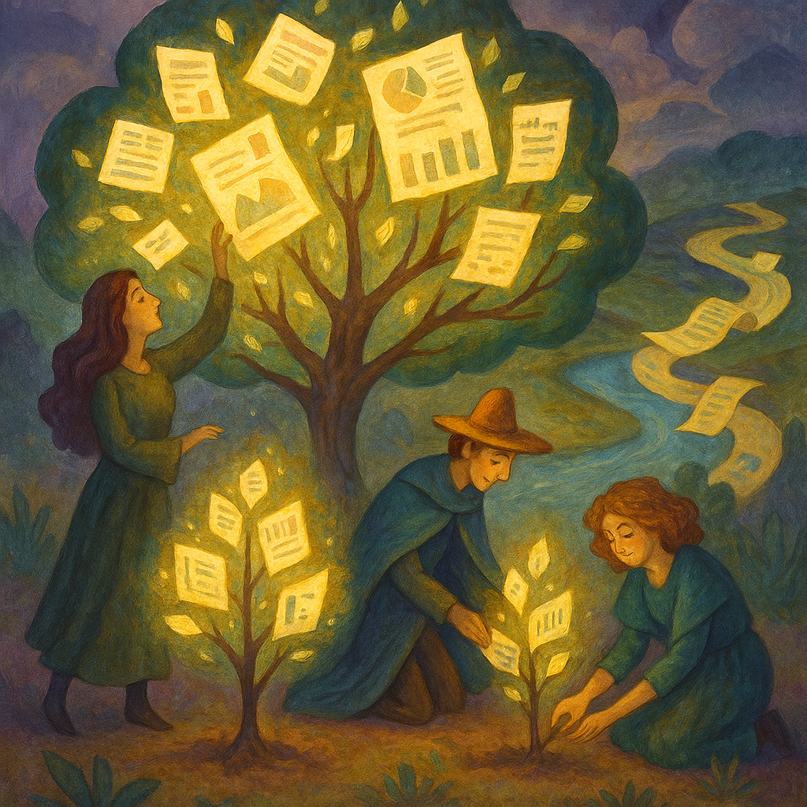
Reusable
Know what you are allowed to do with the dataset
Understand how the dataset is created/collected
Licence
Documentation

Slide 15
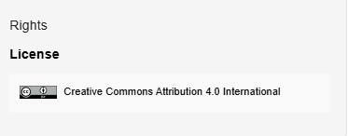
Cabrera Cabrera, X., Puicón Pinday, P. A., Guerra Ayala, M. J., & Reynosa Navarro, E. (2023). Violence Against Women in Peru: An Analysis from the Perspective of Workers at Women's Emergency Centers [Data set]. Zenodo. https://doi.org/10.5281/zenodo.8397779

Slide 16
Cabrera Cabrera, X., Puicón Pinday, P. A., Guerra Ayala, M. J., & Reynosa Navarro, E. (2023). Violence Against Women in Peru: An Analysis from the Perspective of Workers at Women's Emergency Centers [Data set]. Zenodo. https://doi.org/10.5281/zenodo.8397779

Slide 17
FAIR principles
Findable
Accessible
Interoperable
Reusable

Slide 18
FAIR data principles
A trusted Repository will ensure this
A trusted Repository will help you
Findable: F1. (meta)data are assigned a globally unique and persistent identifier
F2. data are described with rich metadata (defined by R1 below)
F3. metadata clearly and explicitly include the identifier of the data it describes
F4. (meta)data are registered or indexed in a searchable resource
Accessible: A1. (meta)data are retrievable by their identifier using a standardized communications protocol
A1.1 the protocol is open, free, and universally implementable
A1.2 the protocol allows for an authentication and authorization procedure, where necessary
A2. metadata are accessible, even when the data are no longer available
Interoperable: I1. (meta)data use a formal, accessible, shared, and broadly applicable language for knowledge representation.
I2. (meta)data use vocabularies that follow FAIR principles
I3. (meta)data include qualified references to other (meta)data
Reusable: R1. meta(data) are richly described with a plurality of accurate and relevant attributes
R1.1. (meta)data are released with a clear and accessible data usage license
R1.2. (meta)data are associated with detailed provenance
R1.3. (meta)data meet domain-relevant community standards
Wilkinson, M et al. The FAIR Guiding Principles for scientific data management and stewardship. Sci Data 3, 160018 (2016).
www.go-fair.org/fair-principles

Slide 19
Essentials to make your data FAIR
Deposit your data in a trusted data repository
“as open as possible as closed as necessary”
Standardize your data during collection
Document your data and ensure quality

Slide 20
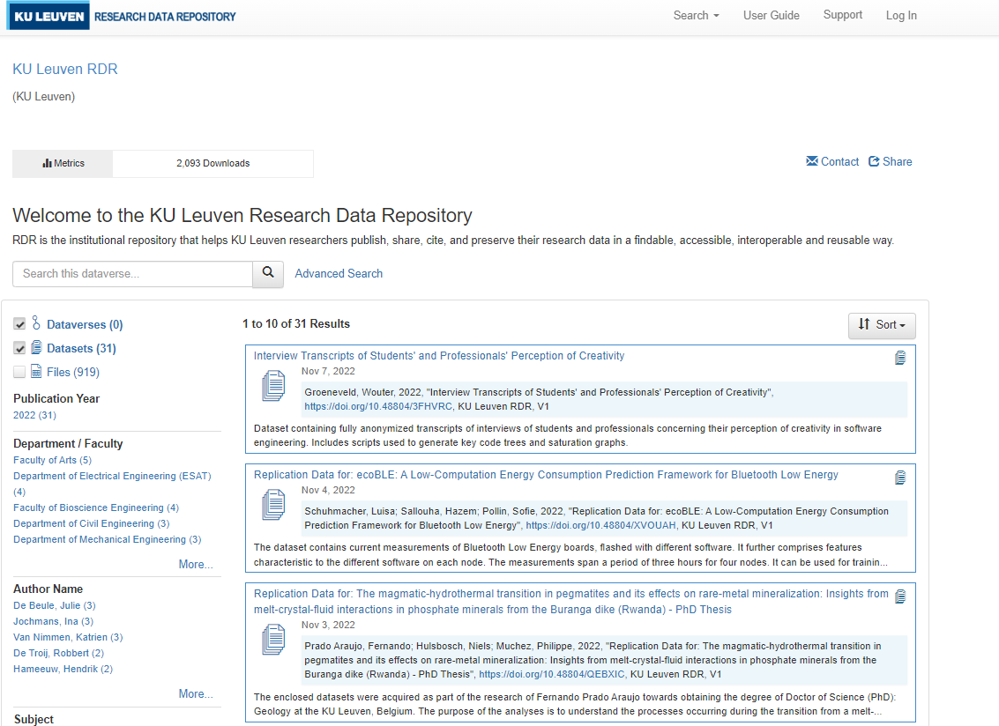

Trusted repository
Institutional
General-purpose

Slide 21

Trusted repository
Institutional
General-purpose
Disciplinary
Commonly used and endorsed in your domain
Internationally recognized

Slide 22
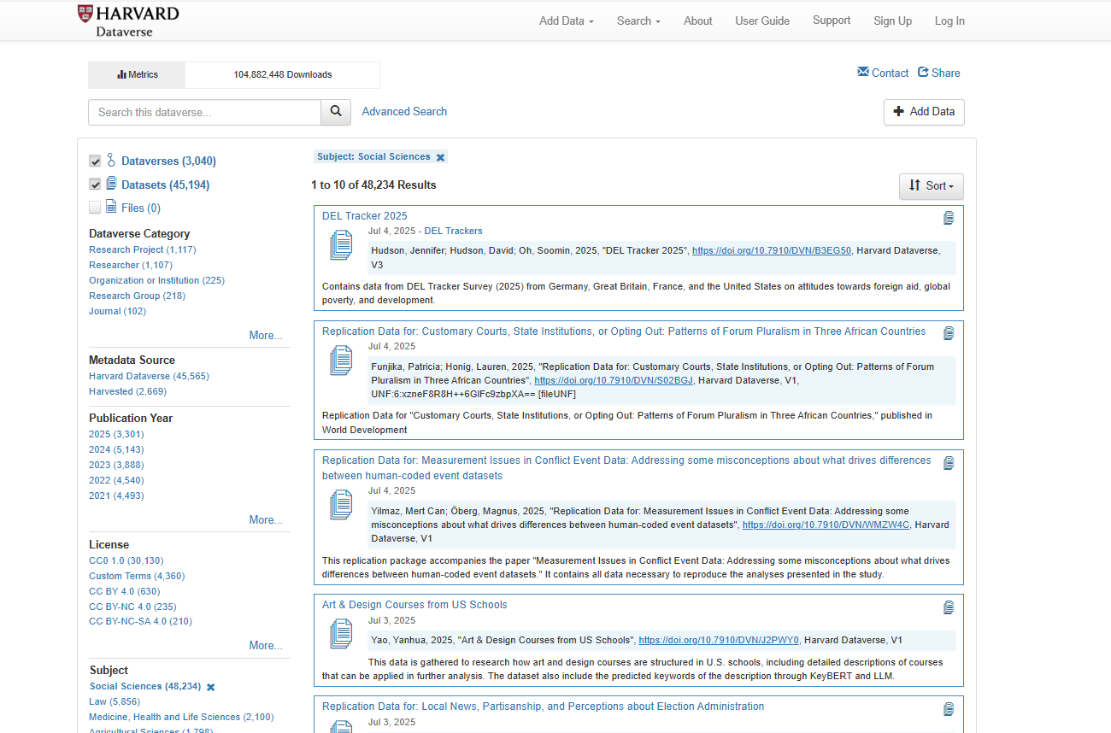

Slide 23
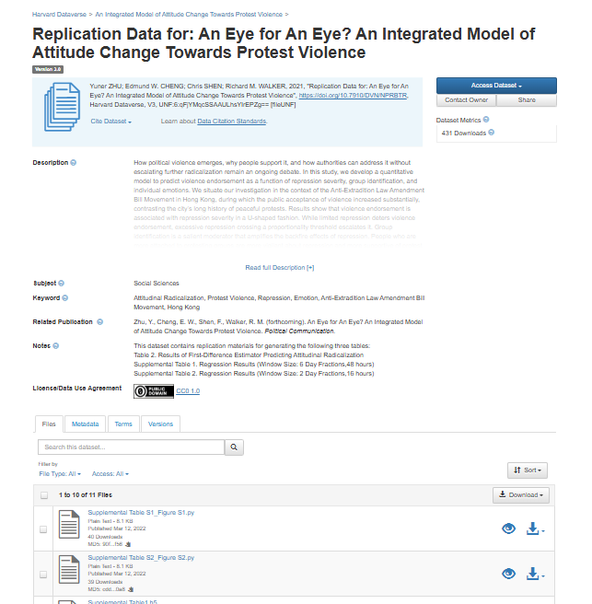
(Citation) Metadata
Data about data
Datafiles
Open or restricted

Slide 24
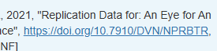

Identifier
(Citation) Metadata
Data about data
Keywords
Related publication
License
Datafiles
Open or restricted

Slide 25
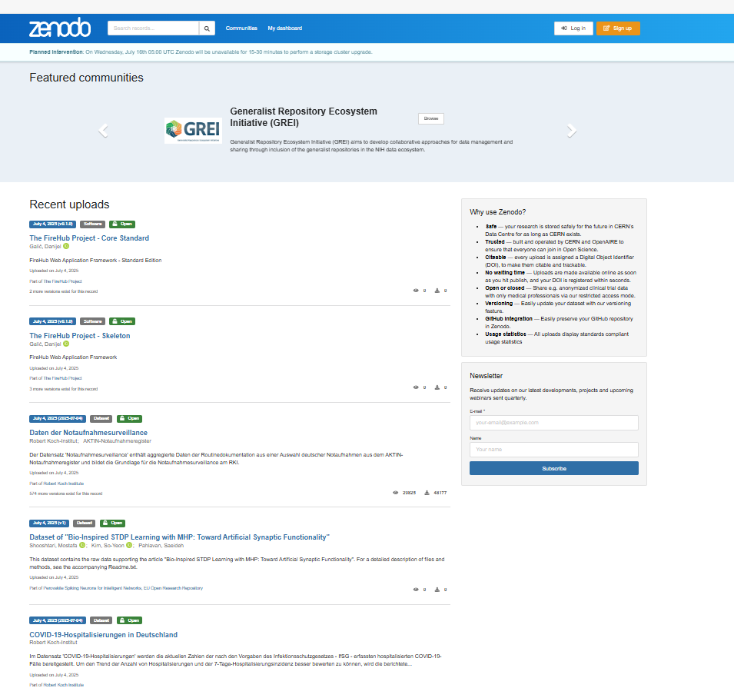

Slide 26
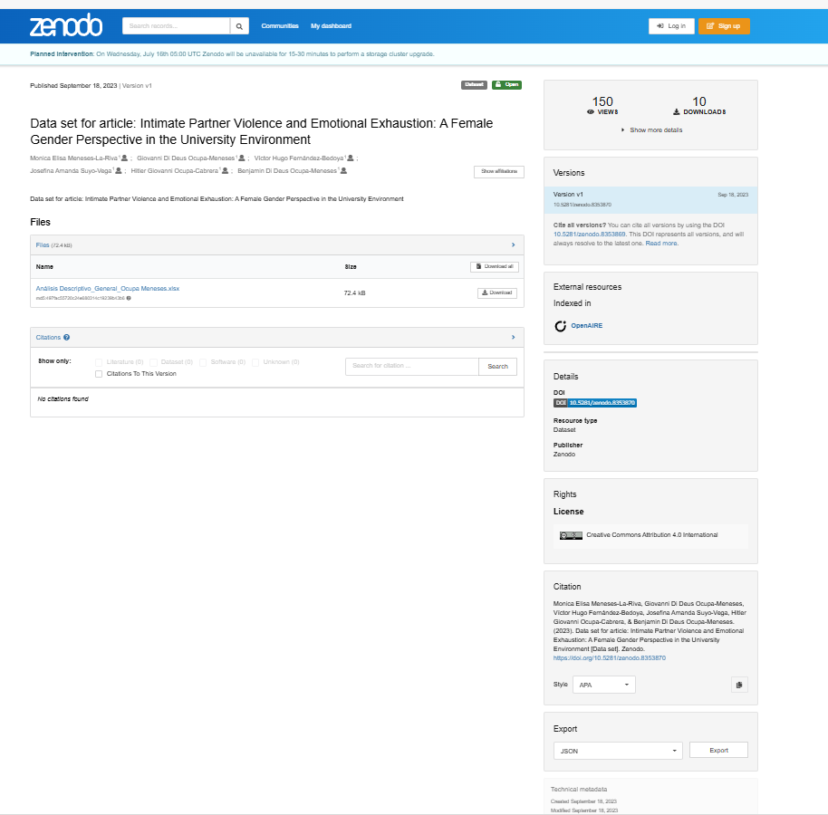
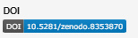


Slide 27
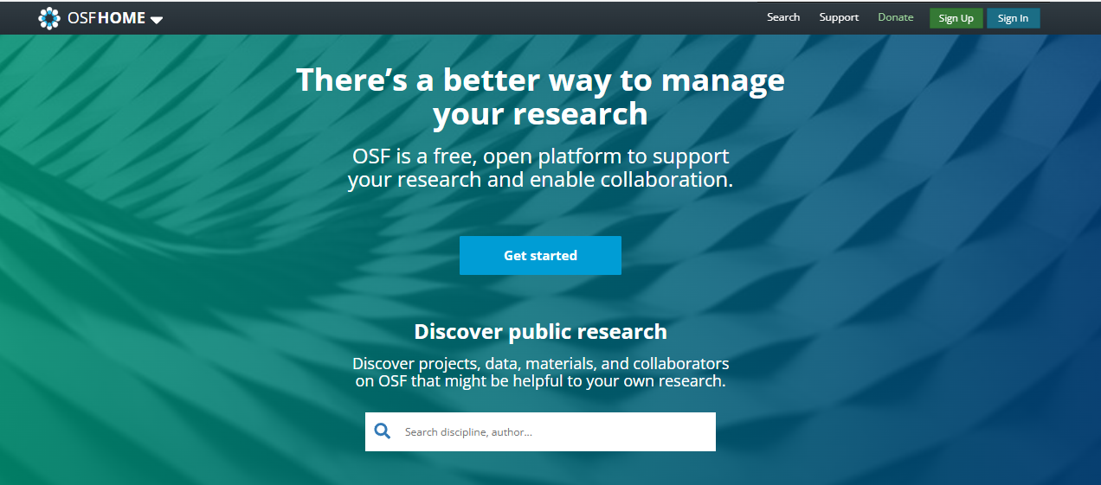

Slide 28
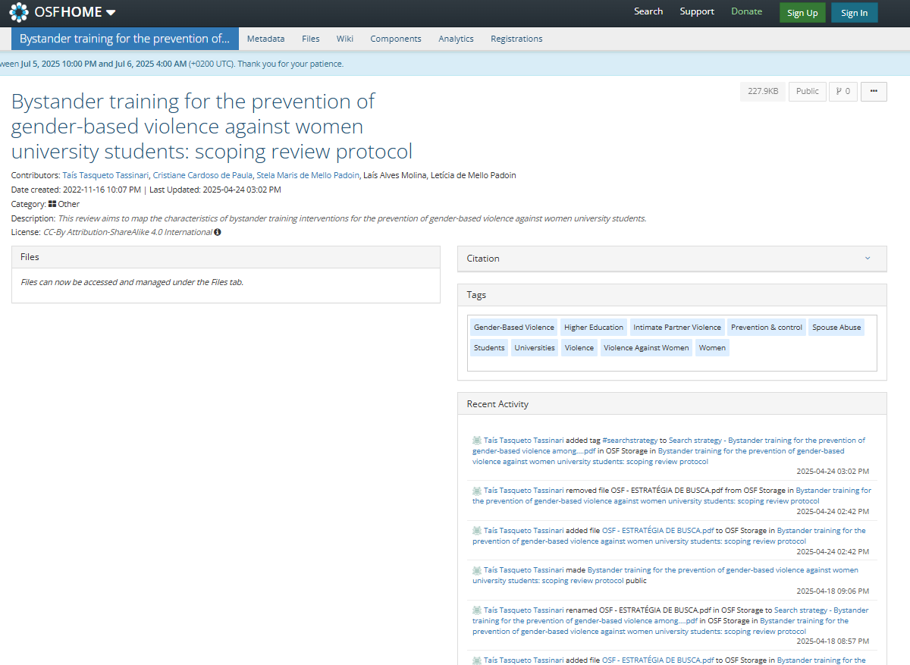

Slide 29
Repository
OSF
+ and – Project based
- American; but other storage locations available (Germany, Canada and Sydney)
Harvard dataverse
+ Well known
+ Focus on social sciences
+ Hosted at Harvard
- US based
Zenodo
+ European, hosted at CERN
+ Open for everyone
- Lots of outputs, no quality control
More repositories on: https://www.re3data.org/

Slide 30
Privacy laws; FAIR ≠ Open
Europe GDPR
Reason for processing
Public interest: e.g. epidemiology, socioeconomic background and career outcome
Consent: consent forms and information letters needed
Only process data that you need and delete when not needed anymore
Only share when needed and with trusted parties
Check with your university what the regulations are relevant for you
Respect participant privacy because you care about them, not just because the laws say so

Slide 31
FAIR personal data
Anonymization: identification impossible
Restricted access

Slide 32
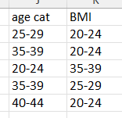
Can you share data openly
Personal data
Pseudonymous
Anonymous?
AI generated data

Slide 33
Check with your institute RDM support if you can share your data openly
Personal data
Pseudonymous
Anonymous?
Still pseudonymous
Anonymous?
Victims of domestic violence with a disability living in or around Leuven
Victims of street harassment in Belgium
AI generated data

Slide 34
Qualitative data
I was assaulted by my ex-boyfriend, John, after I told him I was moving to London for a new job at BlueTech Solutions. It happened in my apartment on Elm Street, and my neighbor, Carla, called the police. I had to take a week off work and stay with my sister in Bristol
I was assaulted by my ex-boyfriend [name] after I told him I was moving to [city] for a new job at [employer]. It happened in my [residence] and [a neighbor] called the police. I had to take [a time period] off work and stay with a family member in a [nearby city]
AI generated data

Slide 35
Qualitative data
Music was my escape. I used to spend hours in my room with my guitar, trying to drown out the shouting downstairs. We lived in a small coastal town where everyone knew each other, and my mom ran a popular café near the boardwalk. Out in public, she was charming and warm—people adored her. But at home, she controlled everything. My dad, who worked from home as a freelance writer, was always walking on eggshells. I saw him shrink over the years, emotionally and physically. It took me a long time to realize that what I witnessed wasn’t just stress or tension—it was abuse. Now, as a music teacher, I try to create a space where kids feel safe to express what they can’t always say out loud.
AI generated data

Slide 36
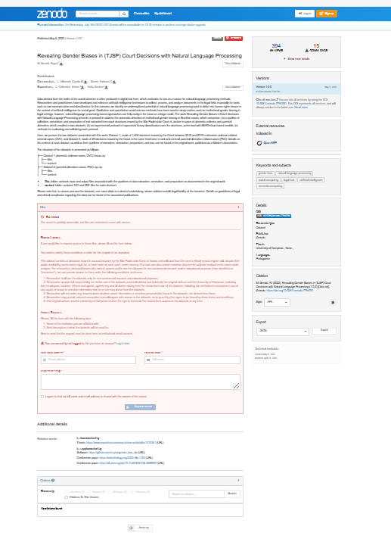
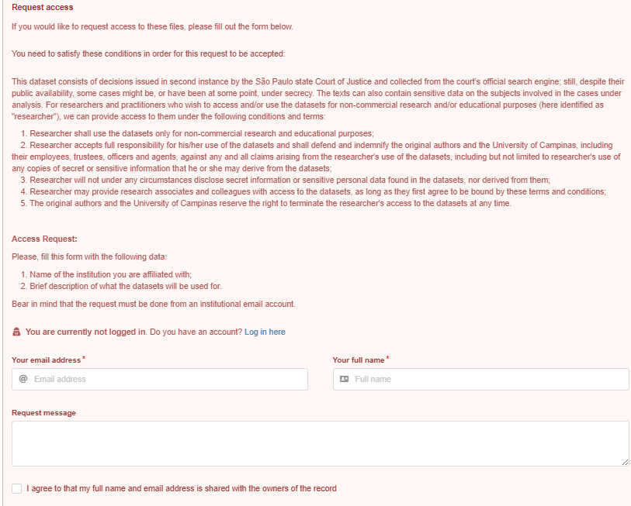

Slide 37
Data Transfer Agreement
Contract between by sharing and receiving party
Details of the data and parties sharing
Ownership of data (sharing party)
For what can data be used (research only, specific project, context)
How long can data be kept (only during project, longer)
Data storage and compliance with local laws
Can data be shared (only with colleagues in same group/institute)

Slide 38
Data Reuse
GDPR: only allow reuse in line with purpose of collection
Study on political attitudes and trust in government institutions
Reuse in study on trust in government institutions in low- and high-income countries around the world: allowed after signing agreement
Reuse of the data to target specific groups with manipulative political ads: not allowed

Slide 39
Sensitive non-personal data
Data of deceased individuals
Ecological data
Data linked to regions
Data linked to minorities (ethnic groups, religious groups, transgenders)
Data linked to small businesses
Neighborhood-level crime statistics
Survey results linking controversial topics (e.g., political extremism, domestic violence) or mental health with minorities
Chemicals in vegetables grown at family farms

Slide 40
Findable and accessible
Use a repository
Restrict access to sensitive data

Slide 41
Interoperable and reusable
Standardize
Document
Licence

Slide 42
Standardization and documentation
Tell others
How you collected/generated your data
What the origin is of your data
How the data is processed and analysed
What the content is of the data
How values should be interpreted

Slide 43
Add documentation
Readme file
Codebook
Protocol
Information letter and empty informed consent forms
Questionnaire used

Slide 44
Standardize
Use standards:
General standards, e.g. date ISO8601: YYYYMMDD
Country codes; standard naming of cities
Use open formats (or formats commonly used in your field)
Csv, txt, pdf, ………

Slide 45
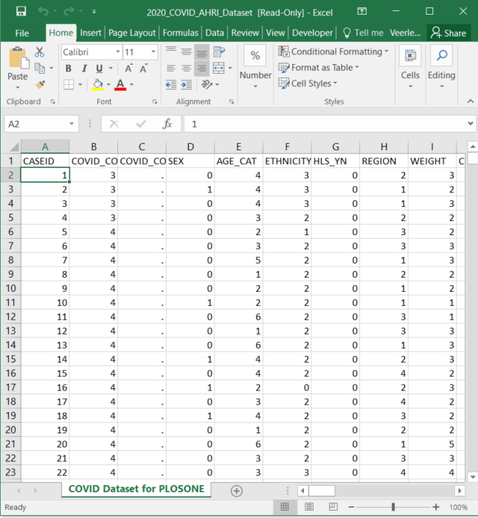
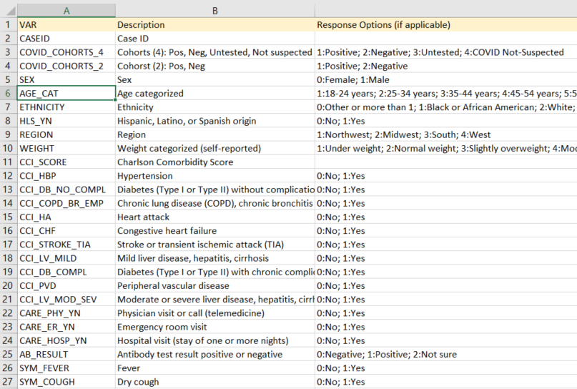
Codebook

Slide 46
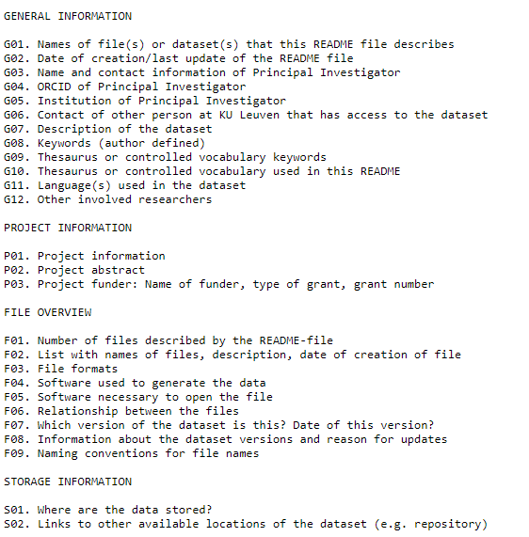
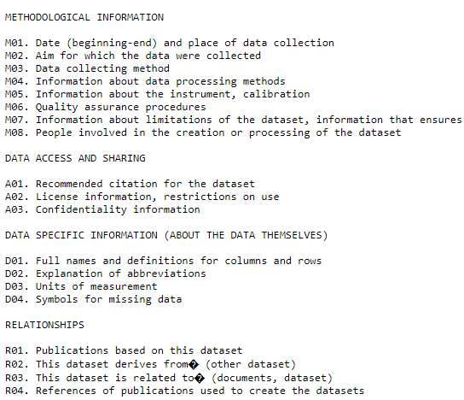
Readme file
https://www.kuleuven.be/rdm/en/guidance/documentation-metadata/README_template

Slide 47
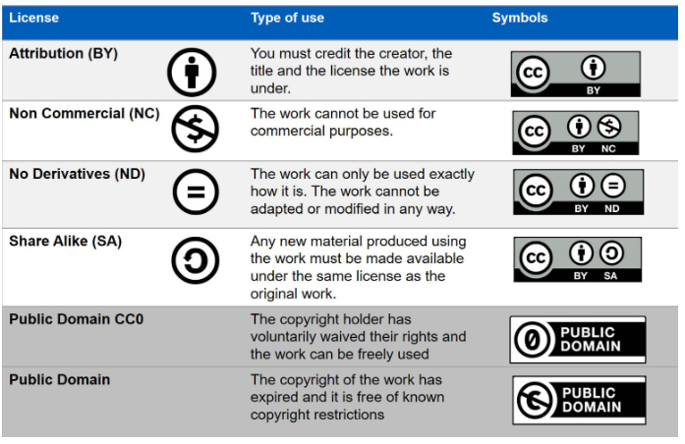
Select a Licence
When you create something, you have copyrights and can assign a licence
CC-BY
Software licence
Data Sharing Agreement
Personal data
Exception: nature’s creations
Repository terms/conditions
Gene sequence
Licence Selector
https://ufal.github.io/public-license-selector/

Slide 48

FAIR data
Funder requirements
Maximise impact
Increase your visibility
Increase your credibility
Enhances collaboration

Slide 49

Make your code FAIR as well
Use a repository with version control
Gitlab or Github
Ensure quality and add documentation
Readme, explanatory lines
Add a license
https://ufal.github.io/public-license-selector/
https://choosealicense.com/
Register your code in a community registry or Zenodo and enable citation
https://www.kuleuven.be/rdm/en/guidance/fair-research-software
https://fair-software.eu/

Slide 50

Questions?

